Slide 1
The Stack ADT

Slide 2

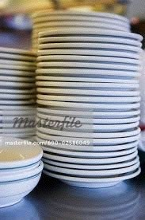
Stacks of Coins and Plates

Slide 3


Stacks of Rocks and Books
TOP OF THE STACK
TOP OF THE STACK
Add, remove rock and book from the top, or else…

Slide 4

Stack at logical level
A stack is an ADT in which elements add added and removed from only one end (i.e.,at the top of the stack).
A stack is a LIFO “last in, first out” structure.

Slide 5
Stack at Logical Level
What operations would be appropriate for a stack?

Slide 6
Stack Operations
Transformers
Push
Pop
change state
Observers
Top
IsEmpty
IsFull
observe state

Slide 7
Stack at Application Level
For what types of problems would be stack be useful for?
LIFO: good for reversing data
If we push a, b, c, d into a stack, and then pop all elements out, we get d, c, b, a
In OS/language: function call stack
Finding Palindromes
Expression evaluation and Syntax Parsing

Slide 8
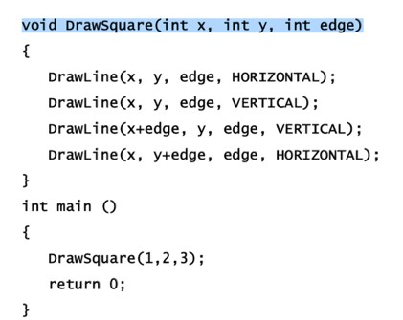
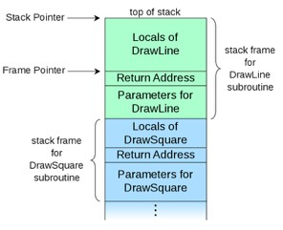
Function call stack
For what types of problems would be stack be useful for?
LIFO: good for reversing data
If we push a, b, c, d into a stack, and then pop all elements out, we get d, c, b, a
In OS/language: function call stack
Finding Palindromes
Expression evaluation and Syntax Parsing

Slide 9
Use stack to reverse
Sometimes you need to output in reverse orders Convert decimal to binary: DisplayInBinary (int num) while (num>0)
digit = num % 2 print digit
num = num / 2
The binary representation is printed backward
Trace it with num=21, output?
Solution: push each digit onto a stack in the loop, after the loop, pop digits out one by one and display it.

Slide 10
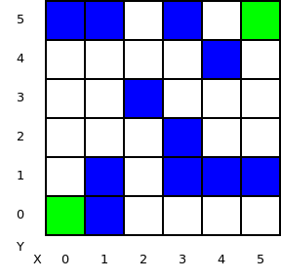
Use stack to backtrack
In maze-walking algorithm, we can use stack to store all nodes that we led us to current node, so that we can backtrack when needed.
Goal: find a path via white blocks from (0,0) to (5,5)
Need to explore: try diff. next step
and backtrack (when reach dead-end): i.e., reverse back to previous node

Slide 11
Stack Implementation
array-based implementation: static or dynamic array
linked-structure implementation

Slide 12
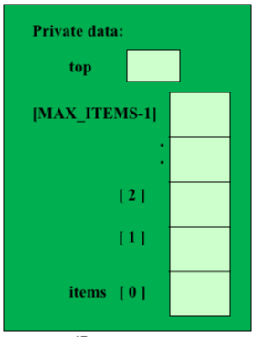
class StackType
{
public:
StackType( );
bool IsFull () const;
bool IsEmpty() const;
2
void Push( ItemType item );
unused
void Pop();
slots/garbag
ItemType Top();
‘c’
‘b’
‘a’
private:
int top; ItemType
};
Stack items
items[MAX_ITEMS]
;
13

Slide 13
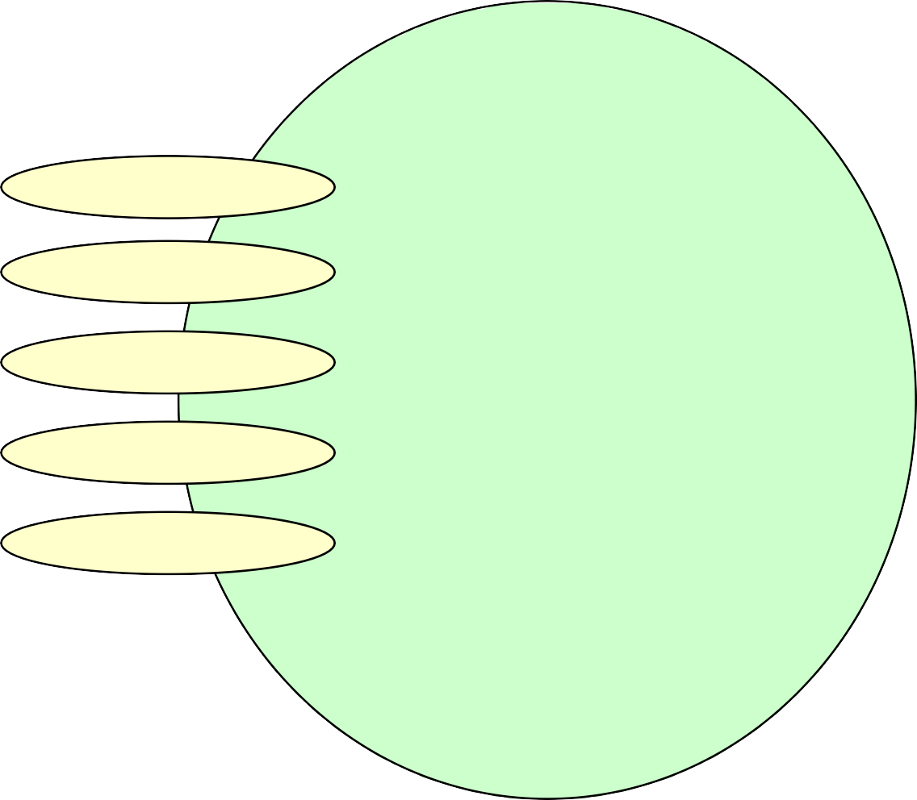
Class Interface Diagram
(Memory reversed to better illustrate concept)
StackType class
Private data:
StackType
IsEmpty
top
[MAX_ITEMS-1]
.
.
.
[ 2 ]
[ 1 ]
IsFull
Push
Pop Top
items [ 0 ]

Slide 14
Initialize stack
How to initialize data member top?
0 or -1
Depends on what top stores:
initialized to 0: If it’s the next open slot
initialized to -1: if it’s the index of stack top element
Need to be consistent in all member functions, Top(), Push(), Pop(), isfull, isEmpty()…
Below we use second option:
StackType::StackType( )
{
top = -1; //index of top element in stack
}

Slide 15
// pre: the stack has been initialized
// post: return true if the stack is empty, false ow
bool StackType::IsEmpty() const
{
return(top == -1);
}
//pre:
//post:
bool StackType::IsFull() const
{
return (top = = MAX_ITEMS-1);
}

Slide 16
void StackType::Push(ItemType newItem)
{
if( IsFull() )
throw FullStack(): top++;
items[top] = newItem;
}
void StackType::Pop()
{
if( IsEmpty() ) throw EmptyStack();
top--;
}
ItemType StackType::Top()
{
if (IsEmpty())
throw EmptyStack(); return items[top];
}

Slide 17
Tracing Client Code
letter
‘V’
char letter = ‘V’; StackType charStack;
charStack.Push(letter); charStack.Push(‘C’); charStack.Push(‘S’);
if ( !charStack.IsEmpty( )) charStack.Pop( );
charStack.Push(‘K’);
while (!charStack.IsEmpty( ))
{ letter = charStack.Top(); charStack.Pop(0)}
Private data:
top
[MAX_ITEMS-1]
.
.
[ 2 ]
[ 1 ]
items [ 0 ]

Slide 18
Stack Implementation: linked structure
One advantage of an ADT is that the implementation can be changed without the program using it knowing about it.
in-object array implementation: has a fixed max. size
dynamically allocated array (as in lab2?): can be grown when needed, but lots of copy!
Linked structure: dynamically allocate the space for each element as it is pushed onto stack.

Slide 19
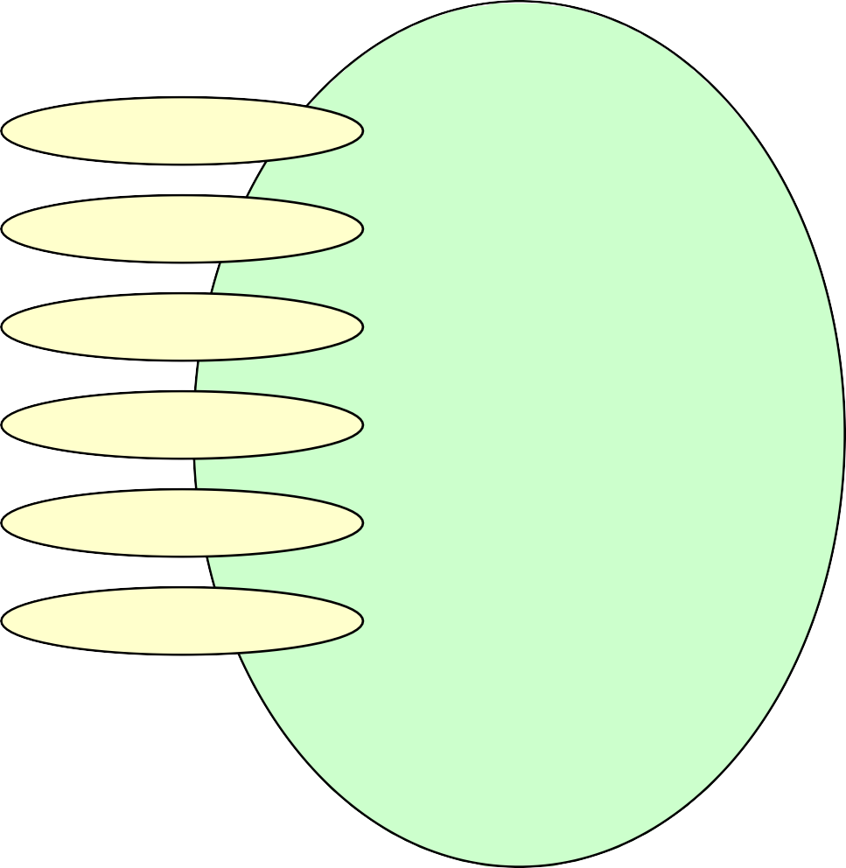
ItemType is char
class StackType
StackType
Top
Private data:
IsEmpty
topPtr
‘C’
IsFull
‘V’
Push
Pop
~StackType

Slide 20
Deleting top element from the stack
item
NodeType* tempPtr;
item = topPtr->info; tempPtr = topPtr; topPtr = topPtr->next; delete tempPtr;
topPtr
‘B’
‘X’
‘C’
‘L’
tempPtr

Slide 21
Deleting top element from the stack
item
‘B’
NodeType* tempPtr;
item = topPtr->info;
tempPtr = topPtr; topPtr = topPtr->next; delete tempPtr;
topPtr
‘B’
‘X’
‘C’
‘L’
tempPtr

Slide 22
Deleting item from the stack
item
‘B’
NodeType* tempPtr; item = topPtr->info;
tempPtr = topPtr;
topPtr = topPtr->next; delete tempPtr;
topPtr
‘B’
‘X’
‘C’
‘L’
tempPtr

Slide 23
Deleting item from the stack
item
‘B’
NodeType* tempPtr; item = topPtr->info; tempPtr = topPtr;
topPtr = topPtr->next;
delete tempPtr;
topPtr
‘B’
‘X’
‘C’
‘L’
tempPtr

Slide 24
Deleting item from the stack
‘B’
item
NodeType<ItemType>* tempPtr; item = topPtr->info;
tempPtr = topPtr; topPtr = topPtr->next; delete tempPtr;
topPtr
‘X’
‘C’
‘L’
tempPtr

Slide 25
Array vs Linked Structure
Drawback of array-based implementation:
at any point of time, array is either filled or not
memory is either not enough,
or wasted
Linked Structure: allocate on demand
Drawback: need to store lots of addresses (in pointer field of node)
if ItemType is small compared to pointer, then it’s not memory efficient

Slide 26
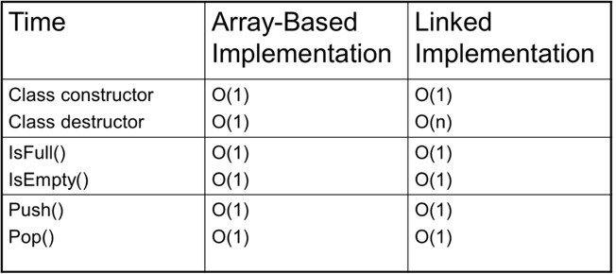
Efficiency comparison

Slide 27
C++ Standard Template Library
a set of C++ class templates that provides common programming data structures and functions
lists, stacks, queues, hash table, many more…
all data structures/container are implemented as class template, which can be parameterized:
vector<int>, vector<double> …
stack<int>, stack<char>
the type in <> is type parameter, specifying the type of items that the stack stores…

Slide 28
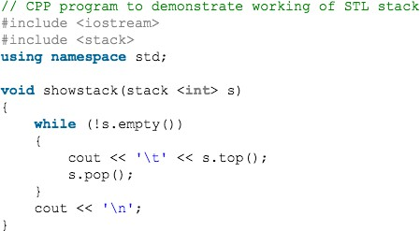
Sample code using STL stack

Slide 29
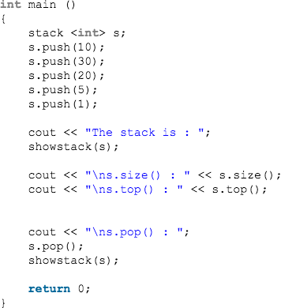
Sample code using STL stack
More info on stack
35

